Slide 1
Unit 7
It’s raining!
Section A Grammar Focus-3c
七年级(下)

Slide 2

Objectives
To learn Present progressive tense
To learn How’s questions

Slide 3

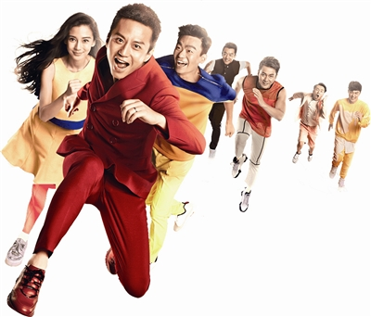
What is/are …doing?
They’re running.

Slide 4
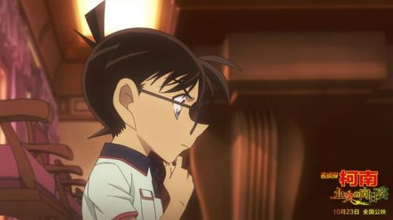
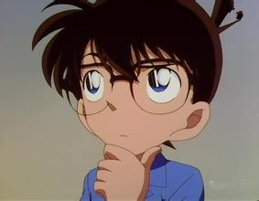
He is thinking.

Slide 5
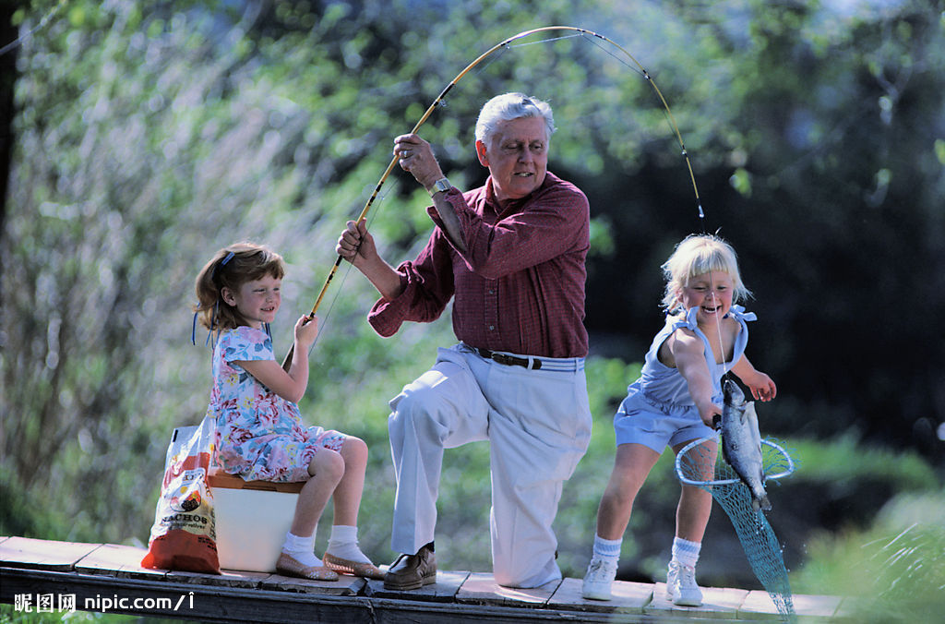
They are fishing.

Slide 6
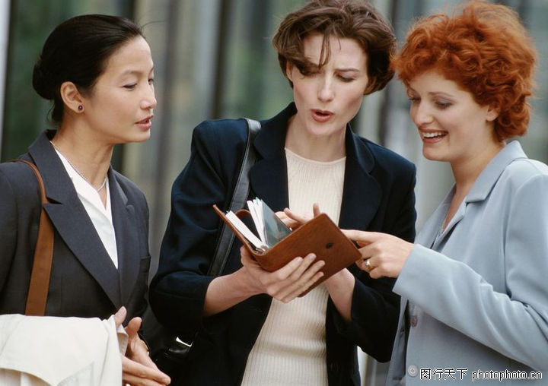
They’re talking with each other.

Slide 7


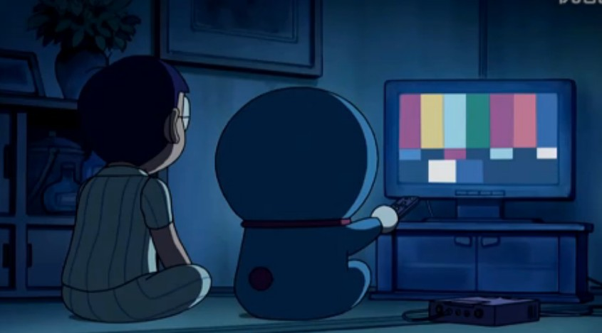
They’re watching TV.

Slide 8
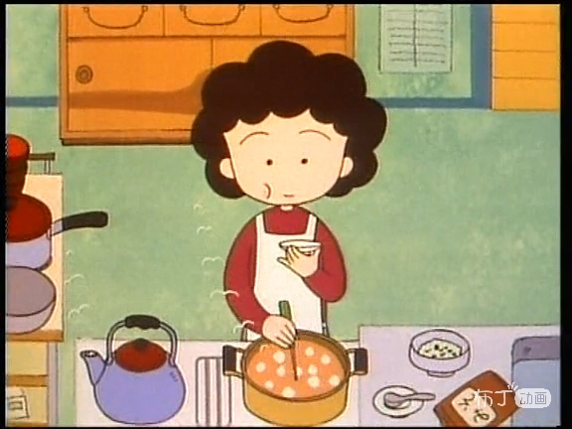
She’s cooking.

Slide 9
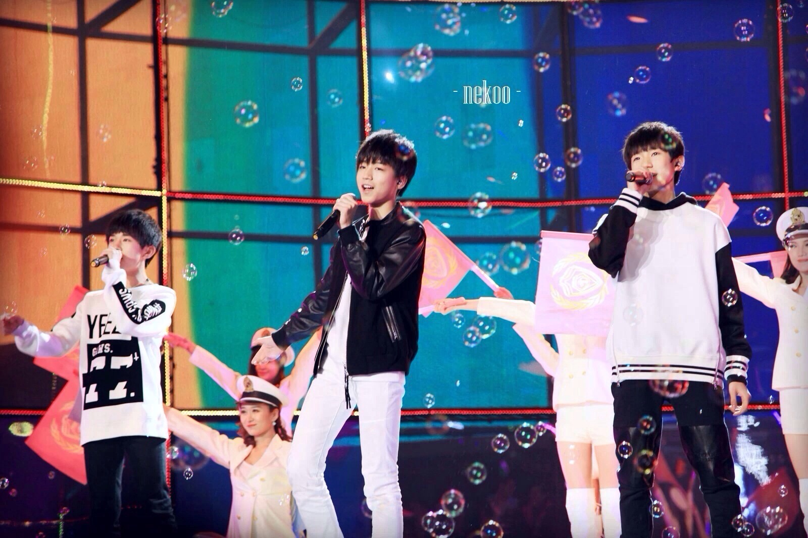
They are singing.

Slide 10
Grammar Focus
It’s cloudy./ It’s sunny.
/ It’s raining.
How’s the weather?
What are you doing?
I’m cooking.
They’re playing
basketball in the park.
What are they doing?
He’s studying at his
friend’s home.
What’s he doing?
Great!/ Not bad./ Terrible!
How’s it going?

Slide 11
Grammar Focus
一、阅读Grammar Focus部分，完成下列句子。
— 天气怎么样？
— _____________________
— 天气多云。/天气晴朗。/天在下雨。
— _________________________________
2. — 你在做什么？_________________
— 我在做饭。______________
How’s the weather?
It’s cloudy./ It’s sunny./ It’s raining.
What are you doing?
I’m cooking.

Slide 12
3. — 他们在做什么？
____________________
What are they doing?
— 他们正在公园里打篮球。
______________________________
______________________________
4. — 他在做什么？_______________
— 他在他朋友家里学习。
________________________________
They’re playing basketball in
the park.
What’s he doing?
He’s studying in his friend’s home.

Slide 13
5. — 情况怎么样？
___________________
— 很好！/不错。/ 糟糕！
_________________________
How’s it going?
Great! / Not bad./ Terrible!

Slide 14
探究乐园
1. 疑问副词 how 用来询问天气。
今天天气怎么样？
_______ the weather today?
【拓展】询问天气还可以说：
_______ the weather _____?
How’s
What’s
like

Slide 15
2. how 用于问候，打招呼
你好吗？________________
你那里情况如何？ _______________
How are you?
How’s it going?
3. how 用来询问方式或手段。
你怎样去上学？
_____ do you go to school?
How

Slide 16
4. how 用来询问年龄
你弟弟多大年龄？
_____ ____ is your brother?
5. How 用于询问价格
那件紫色的毛衣多少钱？
_____ _____ is the purple sweater?
How old
How much

Slide 17
3a. Fill in the blanks with the correct
forms of the verbs in the box. Then practice the conversation with a partner.
be play study talk do make
1. A: What are you doing?
B: I ________ my homework. I
always____ my homework in the
evening.
2. A: What’s John doing right now?
B: He_________ soccer. He______
soccer every Saturday.
am doing
do
is playing
plays

Slide 18
3. A: ____Julie________ English right now?
B: No, she isn’t. She__________ Chinese.
4. A: What are Julie and Jane doing?
B: They__________ soup. They can
______ very good soup.
5. A: ___ Lisa________ on the phone again?
B: Yes, she_____ on the phone for three
hours every day!
Is
studying
is studying
are making
make
Is
talking
talks

Slide 19
反思总结
根据上下文的问句和答语来确定空格处的意思, 特别是每个空格后面的词汇。
根据上下文的时态及时间状语来确定句子的时态。如: right now 为现在进行时态的时间状语。而 usually，every Saturday 及 every day 是一般现在时态的时间状语。

Slide 20
3b. Yuan Yuan from CCTV is
interviewing people in five different
places. Fill in the chart below.
How’s the weather? | What are they doing?
It’s sunny and warm.
He’s playing the guitar.
It’ windy.
They’re hiking.
It’s snowing.
They’re cooking.
It’s hot and humid.
He’s writing.
It’s raining.
They’re playing soccer.

Slide 21
Review
课时重点回顾
- How’s the weather there?
- It’s snowing.
What are you doing?
I’m doing my homework /
playing soccer.

Slide 22
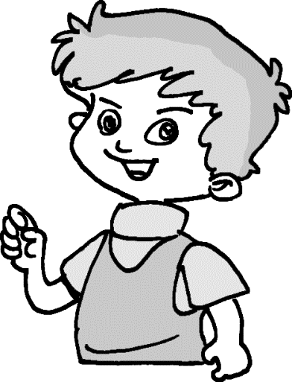
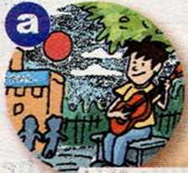
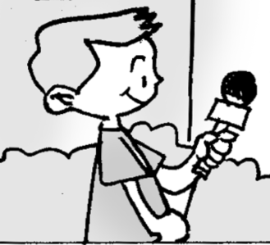
How’s the weather?
It’s sunny.
What’s he doing?
He’s playing the guitar.

Slide 23
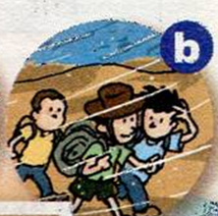
How’s the weather?
It’s windy.
What are they doing?
They’re walking to school.

Slide 24
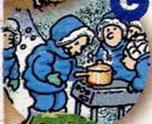
How’s the weather?
It’s snowy.
What are they doing now?
They’re making soup.

Slide 25

How’s the weather?
It’s cool.
What is he doing?
He’s reading a book.

Slide 26
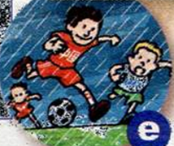
How’s the weather?
It’s raining.
What are they doing?
They’re playing soccer.

Slide 27
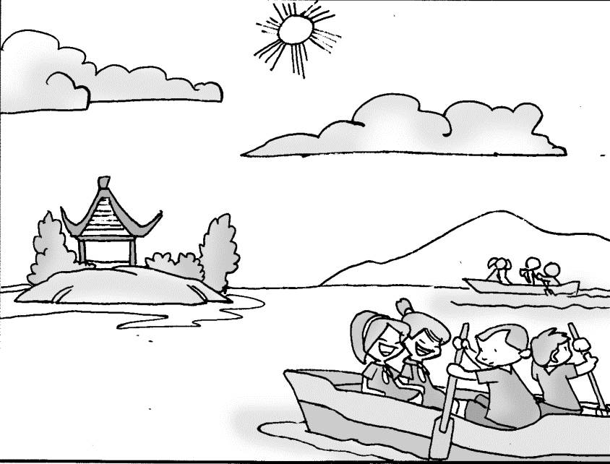
看图片，补全对话。
Practice
A: ______ the weather?
B: It’s ______.
A: What ____ they _____?
B: They ___ ________ on the lake.
How’s
sunny
are doing
are boating

Slide 28
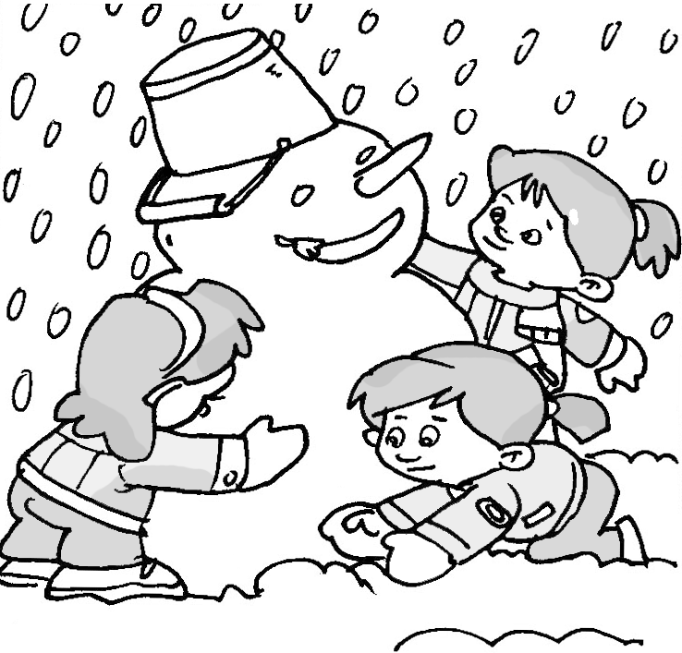
A: _______ the ________?
B: It’s ______.
A: _____ are _____ doing?
B: _____ are ________ a _________.
How’s weather
snowy
What they
They making snowman

Slide 29
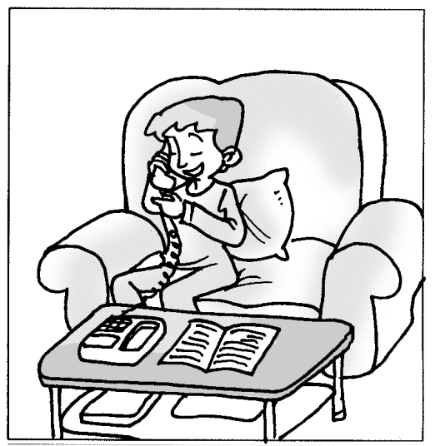
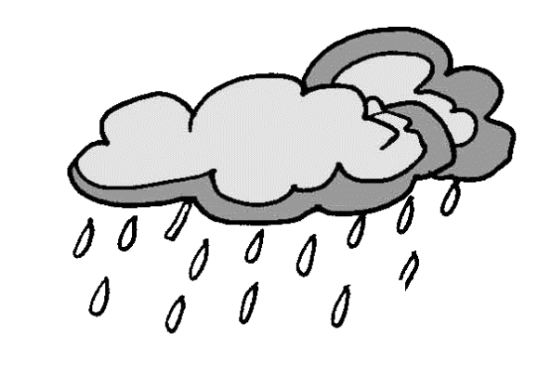
How’s weather
A: _______ the ________?
B: It’s ________.
A: _______ is _____ doing?
B: ____ is ________ on the _______.
raining
What he
He talking phone

Slide 30
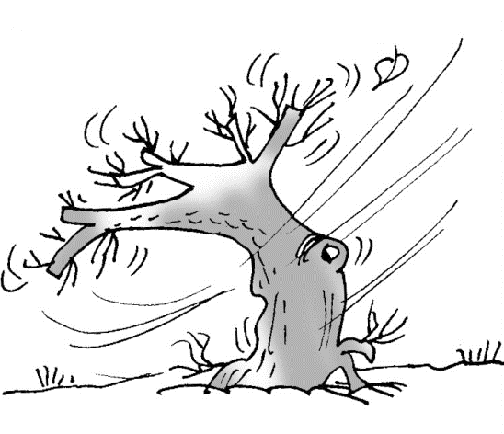
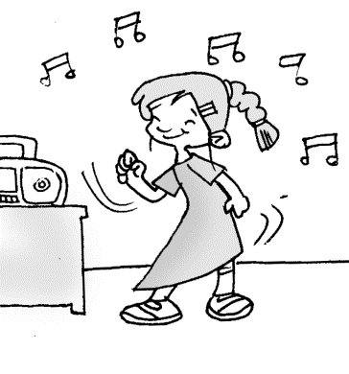
A: _______ the ________?
B: It’s ______.
A: _______ she doing?
B: ____ is __________ to _______.
How’s weather
windy
What’s
She listening music

Slide 31

选择正确答案。
1. Just a minute! My brother ____ his car in the garden.
A. washes B. is washing
C. washed D. will wash
2.— Can Peter play games with us, Mrs. Hawking?
— Wait a minute. He _____ a shower.
A. is taking B. takes
C. took D. was taking

Slide 32
3. — Here comes the bus! Where is our principal?
— She can't go to the museum with us. She _____ some visitors around our school.
A. is showing B. shows
C. has showed D. was showing
4. — Hey, Tom. Let's go swimming.
— Just a moment. I _____ a message.
A. send B. sent
C. am sending D. have sent

Slide 33
5. You ____. Don't talk on the phone.
A. will drive B. are driving
C. were driving D. have driven
6. — Mum, it's late. Why are you still here?
— Dad hasn't come back yet. I ____ for him.
A. am waiting B. was waiting
C. waited

Slide 34
7. — I can’t find David. Where is he?
— He _______ for tomorrow’s
competitions at home.
A. prepares B. is preparing
C. has prepared D. prepared
8. Look! Sam ________ TV happily on the
sofa.
A. is watching B. watches
C. watched

Slide 35
9. Tom wants to be a singer and he_____. singing lessons to do it.
A. took B. has taken
C. is taking D. was taking.
10. — Julie, what ____ in your hand?
— Look! It’s a new iPad for my daughter.
A. do you hold B. are you holding
C. were you holding D. will you hold

Slide 36
11. Today’s young people can’t live without smart phones. They keep their hands on the phones wherever they go, even while they ____ meals.
A. had B. will have
C. are having D. were having
12. Look, so many passengers ____ with their smart phones on the underground.
A. played B. will play
C. are playing D. have played

Slide 37
13. I have to be off now. My friends ____ outside.
A. wait B. are waiting
C. have waited D. were waiting
14. — Sam, let’s go and play basketball.
— Not now. I _____ Dick with his English.
A. help B. helped
C. am helping D. have helped

Slide 38
15. — Alice, would you mind not playing
the guitar? I _____ on the phone.
— Oh, sorry, mom.
A. talked B. talk
C. was talking D. am talking

Slide 39
Homework
1. 背诵Grammar Focus中的句子。
2. 将3b中的图片a、b、e编写成三个小对话。对图片中所描述的天气及人物的活动进行问答。
A: __________
B: __________
A: __________
B: ___________

Slide 40
Thank You!

